Slide 1
Embedded Systems and IOT

Slide 2
UNIT 2
Decision making with if statement, If…. else statement, Switch statement, GOTO statement, The While and Do – While statements, For statement, Why Functions, Types of Functions, Multi-functional program, Return values & their types

Slide 3
Control statements in C Programming Language:
To control the flow of program execution c programming languages uses control statements.
C provides two sytles of flow control:
• Branching (or) Selectional statements
• Looping ( or ) Iterative statements
Branching is deciding what actions to take and looping is deciding how many times to take a certain action.
Selectional statement are used to make one-time decisions in C Programming, that is, to execute some code/s and ignore some code/s depending upon the test expression.

Slide 4
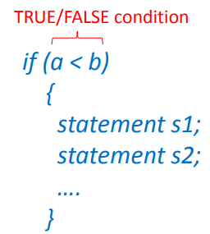
IF STATEMENT
Execute a set of statements if and only if some condition is met
The if statement checks whether the text expression inside parenthesis () is true or not.
If the test expression is true, statement/s inside the body of if statement is executed but if test is false, statement/s inside body of if is ignored.

Slide 5
Syntax of IF statement
if (test expression)
{
statement/s to be executed if test expression is true;
}

Slide 6
Example : Interfacing of IR sensor and buzzer with arduino
int irsensor = 2;
int buzzer = 13;
void setup() {
pinMode(irsensor, INPUT);
pinMode(buzzer, OUTPUT);
}
void loop() {
if ( digitalRead(irsensor) == HIGH )
{ digitalWrite(buzzer, HIGH);
}
if ( digitalRead(irsensor) == LOW )
{ digitalWrite(buzzer, LOW);
}
}

Slide 7
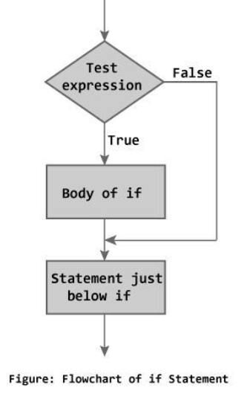
Flow chart of IF Statement

Slide 8
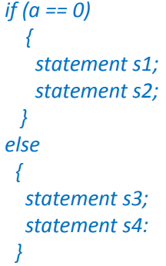
IF ELSE STATEMENT
Execute one set of statements if a condition is met and an alternate set if the condition is not met.
The if...else statement is used if the programmer wants to execute some statement/s when the test expression is true and execute some other statement/s if the test expression is false.

Slide 9
Syntax of if...else
if (test expression)
{
statements to be executed if test expression is true;
}
else
{
statements to be executed if test expression is false;
}

Slide 10
Example
int switchPin = 2;
int ledPin = 13;
void setup() {
pinMode(ledPin, OUTPUT);
pinMode(switchPin, INPUT);
}
void loop()
{
if ( digitalRead(switchPin) == HIGH )
{
digitalWrite(ledPin, HIGH);
}
else
{
digitalWrite(ledPin, LOW);
}

Slide 11
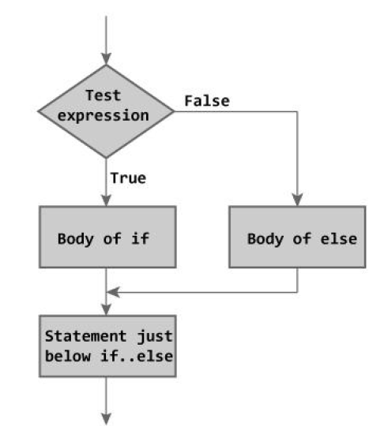
Flow chart of IF ELSE Statement

Slide 12
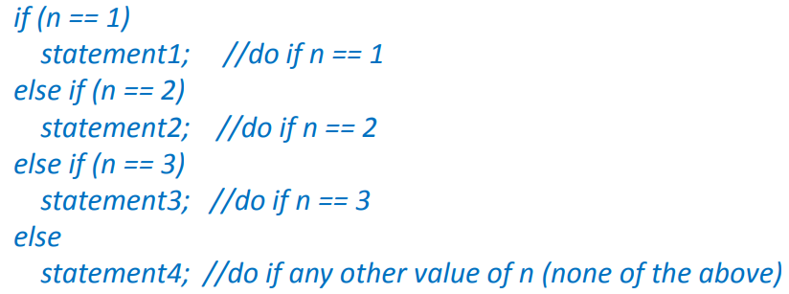
Nested if...else statement (if...elseif....else Statement)
Makes Multi-way decision, with expressions evaluated in a specified order
The nested if...else statement is used when program requires more than one test expression.

Slide 13
Syntax of nested if...else statement
if (test expression1){
statement/s to be executed if test expression1 is true;
}
else if(test expression2) {
statement/s to be executed if test expression1 is false and 2 is true;
}
else if (test expression 3) {
statement/s to be executed if text expression1 and 2 are false and 3 is true;
}
.
.
else {
statements to be executed if all test expressions are false;
}

Slide 14
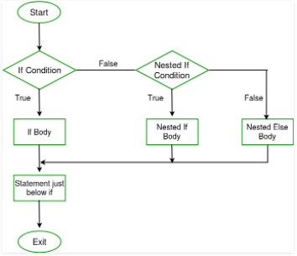
Flow of NESTED if Else

Slide 15
How else if ladder.. works?
The nested if...else statement has more than one test expression.
If the first test expression is true, it executes the code inside the braces{ } just below it. But if the first test expression is false, it checks the second test expression. If the second test expression true, it executes the statement/s inside the braces{ } just below it. This process continues.
If all the test expression are false, code/s inside else is executed and the control of program jumps below the nested if...else
The ANSI standard specifies that 15 levels of nesting may

Slide 16
Example:
int i = 2;
int j = 3;
void setup ( )
{
Serial.begin(9600);
}
void loop ( )
{
if ( i > j )
{
Serial.println( " I is greater ");
}
else if ( i < j )
{
Serial.println( " J is greater " );
}
else
{
Serial.println( " Both are equal " );
}
}

Slide 17
C PROGRAMMING LOOPS
Loops cause program to execute the certain block of code repeatedly until test condition is false. Loops are used in performing repetitive task in programming. Consider these scenarios:
1. You want to execute some code/s 100 times.
2. You want to execute some code/s certain number
These types of task can be solved in programming using loops.

Slide 18
Types of loops
There are 3 types of loops in C programming:
1. for loop
2. while loop
3. do...while loop

Slide 19
For Loop
The for loop is commonly used for repetitive task or operation or to operate on the group of data/pins in combination with arrays.
The statements inside the curly brackets under for loop are executed repeatedly according to the specified condition.
An increment counter in the for loop is used to increment or decrement the loop repetitions.

Slide 20
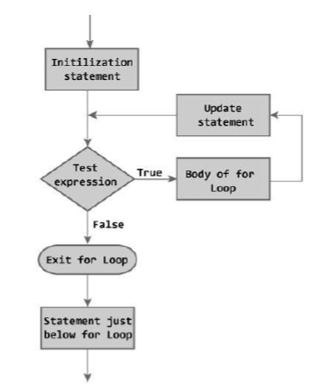
Flowchart of For Loop

Slide 21
For Loop Syntax
for (initialization; condition; increment)
{
\\ statements
}
Where
initialization: It is defined as the initialization of the variable.
condition: The condition is tested on every execution. If the condition is true, it will execute the given task. The loop ends only when the condition becomes false.
increment: It includes the increment operator, such as i + +, i - - , i + 1, etc. It is incremented each time until the condition remains true.

Slide 22
Example
For example,
for ( i = 0 ; i < 5 ; i + +)
The above statement will execute the loop for five times. The values of i will be from 0 to 4.
If the statement is:
for ( i = 0 ; i < = 5 ; i + +)
The above statement will execute the loop six times. The values of i will be from 0 to 5.

Slide 23
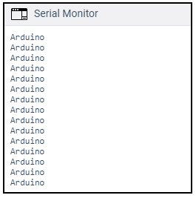
Code Example 1:
To print a message 'Arduino' 15 times.
To print a message 15 times or more is quite complicated using Serial.println ( ), as the code will become too lengthy.
To overcome this, programmers prefer to use for loop to execute a task multiple times, while using a single statement.
int i;
void setup ( )
{
Serial.begin(9600);
for ( i = 0 ; i < 15 ; i ++ )
{
Serial.println( "Arduino");
}
}
void loop ( ) {
}

Slide 24
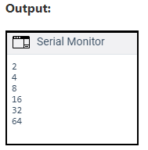
Code Example 2:
To use a multiplication increment
Consider the below code
int x;
void setup ( )
{
Serial.begin(9600);
for (x = 2; x < 100; x = x * 2)
{
Serial.println(x);
}
}
void loop ( ) {
}

Slide 25
Code Example 3
for (int i=0 ; i <= 255; i= i+ 5)
{
analogWrite(buzzer, i);
delay(30);
}
for (int i = 255; i >= 0; i=i-5)
{
analogWrite(buzzer, i);
delay(30);
}
}

Slide 26
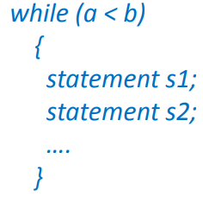
WHILE LOOP STATEMENT:
Repeat a set of statements (a “loop”) as long as some condition is met

Slide 27
While loop
The while loop() is the conditional loop that continues to execute the code inside the parentheses until the specified condition becomes false.
The while loop will never exit until the tested condition is changed or made to stop. The common use of a while loop in arduino
includes sensor testing, calibration (calibrating the input of sensor), variable increment, etc.

Slide 28
Syntax of while loop
while (condition)
{
// code or set of statements
}
The while loop checks whether the test expression is true or not. If it is true, code/s inside the body of while loop is executed,that is, code/s inside the braces { } are executed. Then again the test expression is checked whether test expression is true or not. This process continues until the test expression becomes false.

Slide 29
Example of While loop
variable = 0;
while (variable < 100)
{
// performs the specified task 100 times repeatedly
variable++ ; // increments after every execution
}
The above code inside the curly braces in while loop will execute continuously and repeatedly as long as the variable is less than 100.

Slide 30
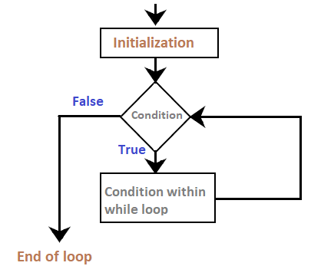
Flowchart

Slide 31
Code example 1
int a = 0;
void setup()
{
Serial.begin(9600);
while( a < 5)
{
Serial.println("Welcome to Arduino");
a = a + 1;
}
}
void loop()
{
}

Slide 32
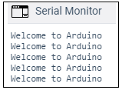
Code example 1
Output: The message inside the loop will be printed five times, as shown below:
Explanation: At first, we have defined the variable a as 0, and initialized the serial monitor as usual (means Serial.begin()). The loop first checks the condition specified within the parentheses. At first, a =0. The condition is true (0 < 5). The code inside the curly braces will execute, and the message is printed.
Now, the value of a is incremented (added 1 to a), and the loop executes again.

Slide 33
Do...while loop
The working of the do-while loop is similar to the while loop.
Only difference between these two loops is that, in while loops, test expression is checked at first but, in do...while loop code is executed at first then the condition is checked. So, the code are executed at least once in do...while loops.
Notice, there is semicolon in the end of while (); in do...while loop.

Slide 34
Syntax of do...while loops
do
{
// code or set of statements
} while (condition);
where,
condition: It specifies the boolean expression, which determines the condition to be true or false.
At first codes inside body of do is executed. Then, the test expression is checked. If it is true, code/s inside body of do are executed again and the process continues until test expression becomes false(zero).

Slide 35
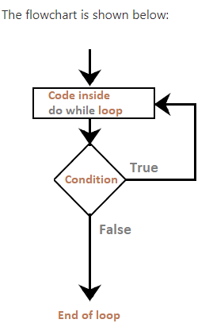
Flowchart of Do….while loop

Slide 36
Do while Loop: Example
int b = 0;
do
{
delay(100); // wait for stabilization of the sensors
b = readSensors(); // It checks the sensors
}
while (x < 100); // specified condition

Slide 37
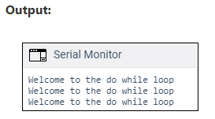
Code example: Program
int a = 0;
void setup()
{
Serial.begin(9600);
do
{
Serial.println("Welcome to the do while loop");
a = a + 1;
} while( a < 3);
}
void loop()
{
}

Slide 38
BREAK & CONTINUE STATEMENT:
There are two statements built in C programming, break; and continue; to alter the normal flow of a program.
Loops perform a set of repetitive task until text expression becomes false but it is sometimes desirable to skip some statement/s inside loop or terminate the loop immediately without checking the test expression.
In such cases, break and continue statements are used. The break;statement is also used in switch statement to exit switch statement.

Slide 39
Break Statement
In C programming, break is used in terminating the loop immediately after it is encountered. The break statement is used with conditional if statement.
Syntax of break statement
break;
The break statement can be used in terminating all three loops for, while and do...while loops.

Slide 40
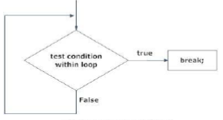
Flow Chart of Break Statement

Slide 41
CONTINUE STATEMENT
It is sometimes desirable to skip some statements inside the loop. In such cases, continue statements are used.
Syntax of continue Statement
continue;
Just like break, continue is also used with conditional if statement.

Slide 42
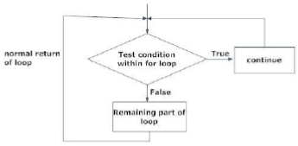
Syntax of Continue Statement

Slide 43
SWITCH CASE STATEMENT:
Decision making are needed when, the program encounters the situation to choose a particular statement among many statements.
If a programmer has to choose one block of statement among many alternatives, nested if...else can be used but, this makes programming logic complex.
This type of problem can be handled in C programming using switch statement.

Slide 44
Syntax of switch...case
switch (n) {
case constant1:
code/s to be executed if n equals to constant1;
break;
case constant2:
code/s to be executed if n equals to constant2;
break;
.
.
default:
code/s to be executed if n doesn't match to any cases;
}

Slide 45
Explanation: Syntax of switch...case
The value of n is either an integer or a character in above syntax.
If the value of n matches constant in case, the relevant codes are executed and control moves out of the switch statement.
If the n doesn't matches any of the constant in case, then the default codes are executed and control moves out of switch statement.

Slide 46
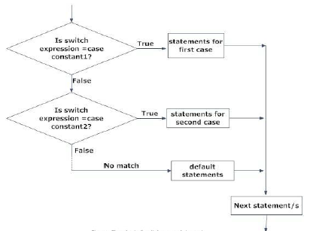
Flow chart of switch...case

Slide 47
GOTO STATEMENT:
In C programming, goto statement is used for altering the normal sequence of program execution by transferring control to some other part of the program.
Syntax of goto statement
goto label;
.............
.............
.............
label:
statement;
In this syntax, label is an identifier. When, the control of program reaches to goto statement, the control of the program will jump to the label: and executes the code below it.

Slide 48
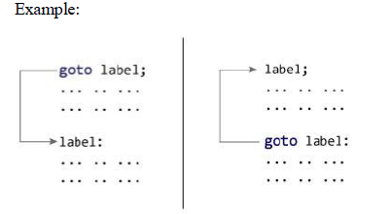
GOTO STATEMENT:

Slide 49
GOTO STATEMENT:
Reasons to avoid goto statement
Though, using goto statement give power to jump to any part of program, using goto statement makes the logic of the program complex and tangled.
In modern programming, goto statement is considered a harmful construct and a bad programming practice.
The goto statement can be replaced in most of C program with the use of break and continue statements.

Slide 50
Array
Arrays a kind of data structure that can store a fixed-size sequential collection of elements of the same type. An array is a sequence of data item of homogeneous value(same type).
In C programming, one of the frequently arising problem is to handle similar types of data. For example: If the user want to store marks of 100 students. This can be done by creating 100 variable individually but, this process is rather tedious and impracticable. These type of problem can be handled in C programming using arrays.

Slide 51
Types of Array
Arrays are of two types:
1. One-dimensional arrays
2. Multidimensional arrays

Slide 52
One-dimensional arrays
Declaration of one-dimensional array
data_type array_name[array_size];
For example:
int age[5];
Here, the name of array is age. The size of array is 5,i.e., there are 5 items(elements) of array age. All element in an array are of the same type (int, in this case).

Slide 53
One-dimensional arrays
Initialization of one-dimensional array:
Arrays can be initialized at declaration time in this source code as:
int age[5]={2,4,34,3,4};
It is not necessary to define the size of arrays during initialization.
int age[]={2,4,34,3,4};
In this case, the compiler determines the size of array by calculating the number of elements of an array.

Slide 54
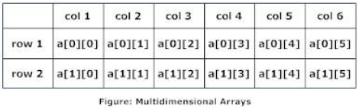
Multidimentional arrays:
C programming language allows programmer to create arrays of arrays known as multidimensional arrays. For example:
float a[2][6];
Here, a is an array of two dimension, which is an example of multidimensional array.
For better understanding of multidimensional arrays, array elements of above example can be thinked of as below:

Slide 55
Multidimentional arrays:
Initialization of Multidimensional Arrays
In C, multidimensional arrays can be initialized in different number of ways.
int c[2][3]={{1,3,0}, {-1,5,9}};
OR
int c[][3]={{1,3,0}, {-1,5,9}};
OR
int c[2][3]={1,3,0,-1,5,9};

Slide 56
Function
A function is a block of statements that performs a specific task.
Let’s say you are writing a C program and you need to perform a same task in that program more than once. In such case you have two options:
Use the same set of statements every time you want to perform the task
Create a function to perform that task, and just call it every time you need to perform that task.
Using option (b) is a good practice

Slide 57
Why we need functions in C
Functions partition large programs into a set of smaller tasks
Helps manage program complexity
Smaller tasks are easier to design and debug. Debugging of the code would be easier if you use functions, as errors are easy to be traced.
Functions can often be reused instead of starting over. So Improves the reusability of the code, same function can be used in any program rather than writing the same code from scratch.
To improve the readability of code.
Reduces the size of the code, duplicate set of statements are replaced by function calls.

Slide 58
Function
A function is “called” by another program to perform a task
– The function may return a result to the caller
– One or more arguments may be passed to the function/procedure

Slide 59
Types of Function
1) Predefined standard library functions
Standard library functions are also known as built-in functions.
There are two required functions in an Arduino sketch or a program i.e. setup () and loop(). Other functions must be created outside the brackets of these two functions.

Slide 60
Types of Function
2) User Defined functions
The functions that we create in a program are known as user defined functions or in other words you can say that a function created by user is known as user defined function.

Slide 61
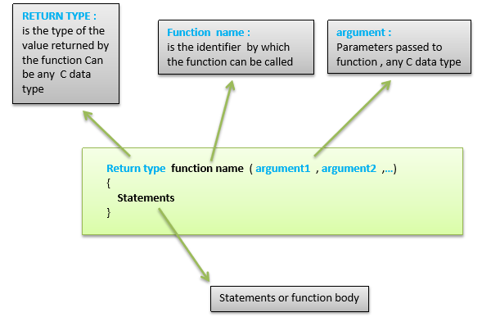
Function Declaration

Slide 62
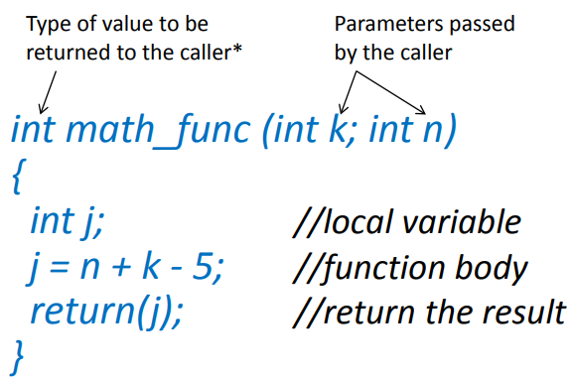
Function Example

Slide 63
Function arguments
Calling program can pass information to a function in two ways
– By value: pass a constant or a variable value
• function can use, but not modify the value
– By reference: pass the address of the variable
• function can both read and update the variable
– Values/addresses are typically passed to the function by pushing them onto the system stack
• Function retrieves the information from the stack

Slide 64
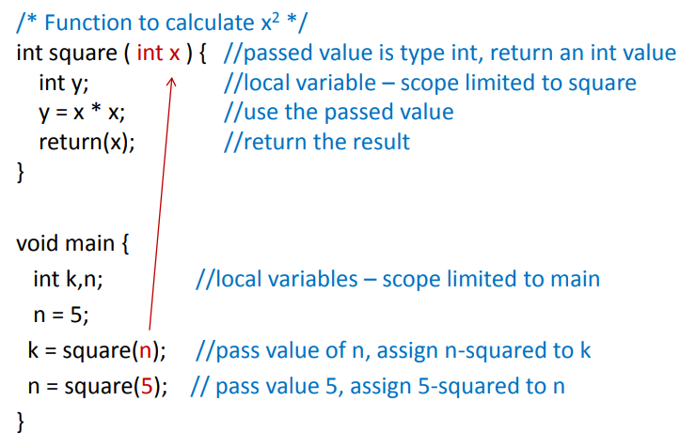
Example: Pass by Value

Slide 65
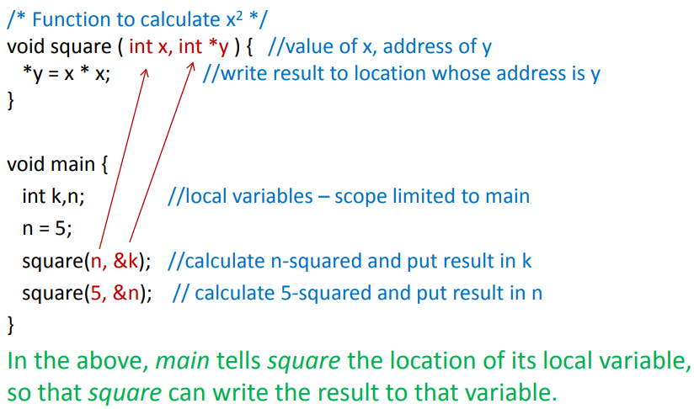
Example: Pass by reference

